Slide 1
Capstone Project
Hina Motiani

Slide 2
Contents
About Data
Data Dictionary
ERD
Business Problem & Visualization
Conclusion

Slide 3
About Data
Restaurant Ratings
Data Collected in Mexico by real users in 2012
Data includes additional information about each restaurant
Also includes their cuisines and each customer and their preferences
Here consumers are highly focused, without them businesses can’t run.
Notes:
Consider talking about:
Data requirements
Data collection
Data processing
Data cleaning
Exploratory data analysis
Modeling and algorithms
Data product
Communication

Slide 4
About Data
Why we choose this dataset
In today’s world every business runs on consumers demand or the businesses which make consumers their first priority.
After reviewing this dataset there is some gap between consumer demand and restaurants which they are offering
Then we created some business problem and get insights, also make some suggestions for restaurant owners.
Notes:
Consider talking about:
Data requirements
Data collection
Data processing
Data cleaning
Exploratory data analysis
Modeling and algorithms
Data product
Communication

Slide 5
Data Dictionary
Most frequent datatypes used are:
VARCHAR(), NVARCHAR(), INT(), DECIMAL()
Total 5 tables are available in restaurants ratings as:
Consumers
Consumer_Preferences
Ratings
Restaurants
Restaurant_Cuisines

Slide 6
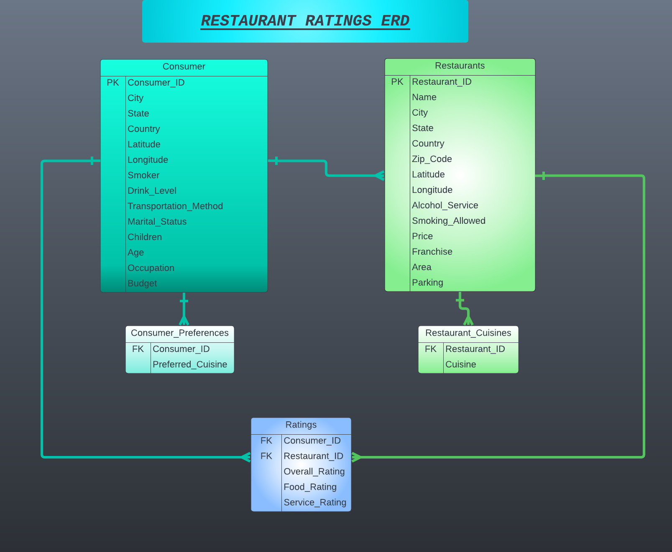
Entity Relationship Diagram (ERD)

Slide 7
Business Problems
Q1How many restaurants get low and high rating ?
First find out the total ratings which are 1161 then we choose overall ratings from ratings
We found out that there are 486 high and 254 low overall ratings for restaurants.

Slide 8
Business Problems
Q2)How many restaurants get low and high rating and by which consumers?
This query is same as earlier, only difference is that here we also mentioned the customers which give rating
There are 136 customers who give overall ratings and ratings are given by same user multiple times.

Slide 9
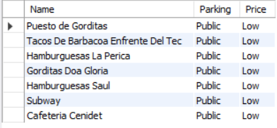
Business Problems
Q3) Select all restaurants where public parking is available and their budget is low?
There are 7 restaurants out of 130 give public parking although their budget is low.

Slide 10
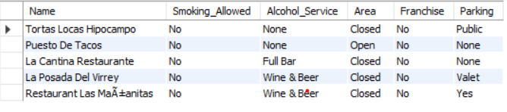
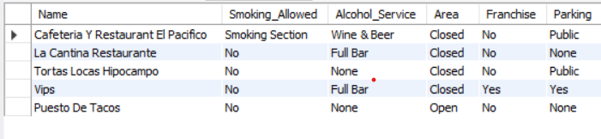
Business Problems High Rated Low Rated
Q4) What can you learn from the top 5 highest rated and lowest rated restaurants ? Do consumer preferences have an effect on ratings?
Through these findings we analyzed that restaurant where smoking is not allowed, alcohol service is not almost allowed, have no franchise, area is closed which provides relax environment and ensures privacy there people gave high ratings.
Whereas we analyzed in lowest rated restaurants that where smoking, alcohol service is allowed, is preferably low rated since it specifies limited people who visits such restaurants.
For Preferences we analyzed that top 3 cuisines are (Mexican, Japanese, Coffee Shop) but only 1 top rated out of 3 have Mexican cuisine, it shows Cuisine not affect the ratings.

Slide 11
Business Problems
Q5) What are the consumer demographics? Does this indicate a bias in the data sample?
Consumer Demographics include Age, City and Budget of Consumer.
Through graph, the bias we find out is that San luis Potosi is the only city where maximum 21 age group people has medium budget and 23 age group has relatively dominant low budget whereas in Ciudad Victoria, lesser 23 age group people earns medium budget than Potosi. People having high budget is no where dominant in any city. This indicates biasness in Consumer Demographics.

Slide 12
Business Problems
Q6) Are there any demand & supply gaps that you have analyzed so for?
Supply here indicates price of restaurant providing cuisine(either high, medium and low) and Demand indicates budget consumer have by which consumer is opting for cuisine.
Whichever restaurants have medium price, maximum “medium” budget people are opting for it. Here it is narrow demand and supply gap between budget and price.
In low price of restaurants, there is wider gap between demand and supply which encourages low price restaurants’ business because maximum medium budget are opting for it than low.
In High price restaurants, High budget people are not going for them than medium budget people which discourages high restaurants’ business expectations.

Slide 13
Business Problems
Q7) If you were invest into restaurants which characteristics would you be looking for?
PART OF RECOMMENDATION AS WELL
By our findings we first check through ratings
We analyze here restaurants who render alcohol, smoking and parking services all and are being rated.
Those restaurants who are giving public parking, allowing smoking section and providing Wine and Beer are highly rated. Similarly, we have analyzed other 2 cases of those allowing alcohol and smoking services along with valet parking service or just allowing parking service. We have deducted that those restaurants that are rendering Smoking Section, Wine and Beer and allowing parking service is less highly rated
Investors must look for 1st option if they are looking for restaurants rendering all services

Slide 14
Business Problems
Q8) What kind of transportation do consumers used to reach restaurants, what are their ages and occupation?
We found out most of consumers using public transport around 82 consumer out of 138.
Consumers are in wide range of ages from 18 to 82, out of which most of customers are 23 years old and Most consumers are students, 113 out of 138.
Students use Public Transport to reach restaurants.

Slide 15
Business Problems
Q9) How many consumers prefer both drinking and smoking in restaurants? Among them which kind of restaurants cuisine do they prefer?
There are 26 out 138 customers who prefer both smoking and drinking, also among 26 most prefer Mexican food.

Slide 16
Business Problems
Q10) What kind of restaurants allows smoking and drinking service in their restaurants?
There are 15 restaurants out of 130 who allows both smoking and drinking and most of restaurants are Bars

Slide 17
Business Problems
Q11) Which city has maximum no of restaurants and which of them are highly rated?
Most of restaurants are located in San Luis Potosi; 84 out of 130, and out of 84 restaurants 46 restaurants that are rated 2 > 1 > 0.

Slide 18
Business Problems
Recommendations;
We have added recommendation in terms of investing in Q7 ( We can have look again)
Those restaurants which are being rated low, they need to work on the cuisines which are now a days preferences of consumers. If they are allowing smoking and alcohol services then they must work on their service rating than Food Rating.
According to trends, those who are renders above services they allot valet parking which standardize restaurant.
If the restaurants are not allowing any of these services then they must focus on food quality rather than service quality, they must have open area for consumers to interact with environment and enjoy their meal.
But preferably, it is to mention that those restaurants which allow smoking and alcohol services are not on favourable side because they are missing the trick of attracting variety of consumers to their restaurant because due to allowing those services, you are limiting your consumers.
Hope this helps restaurant owners of Mexico to maximize their profit.

